Slide 1
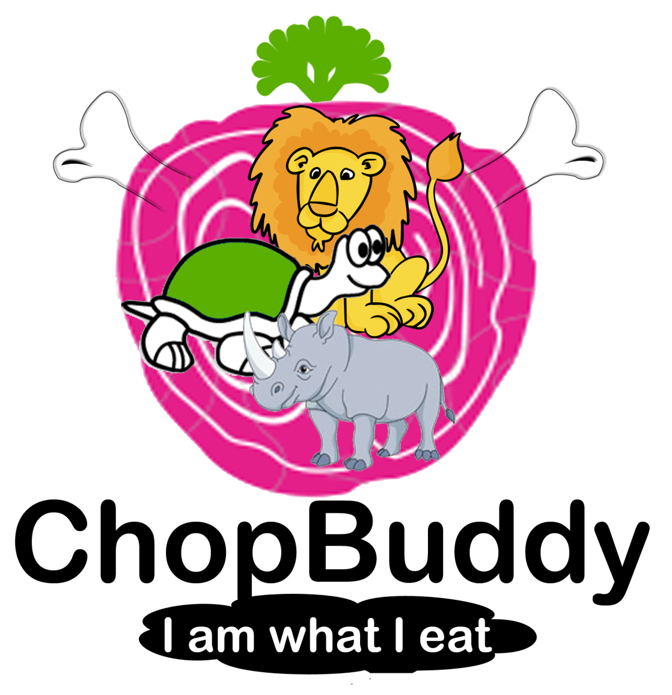
A social game for healthy eating

Slide 2
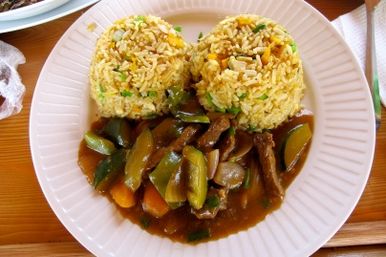
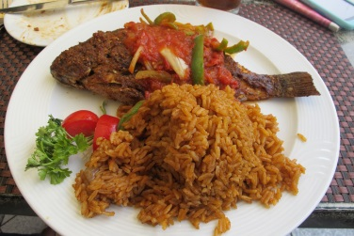
Addressing the problem of poor nutrition in Ghana and beyond
Malnutrition is a complex & major problem in Ghana and the rest of West Africa → Diet quality & diversity are key drivers and what we want to “hack”
Most Ghanaians, regardless of location or wealth, eat a similar diet consisting of staple foods, some vegetables and oil, and little else → 67% of Ghanaians do not have a diverse diet
The main starchy staples consumed are cassava, plantain, yam and cocoyam, with cassava being the most frequently consumed. Increased rice consumption due to its affordability and easy preparation contributes to monotonous un-diverse diets, consumption is currently 38 kg and that is expected to rise to 63kg in 2015.
Lack of dietary diversity and nutrient-dense foods can have a major impact on the nutritional and health status of individuals.
Source: Comprehensive Food Security and Vulnerability Analysis (CFSVA). And National Rice Development Strategy (NRDS) for Ghana.

Slide 3
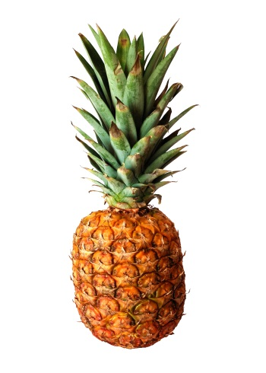
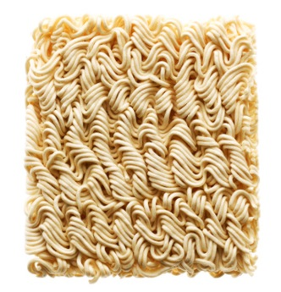
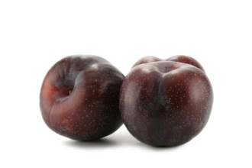
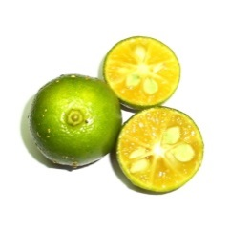
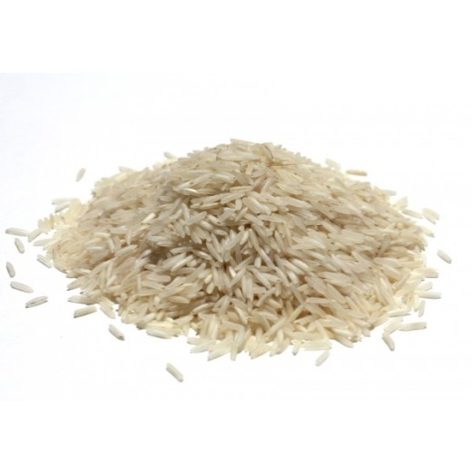
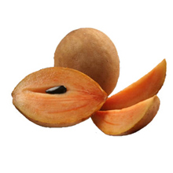
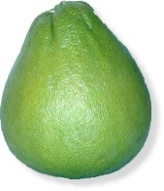
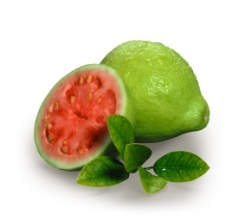
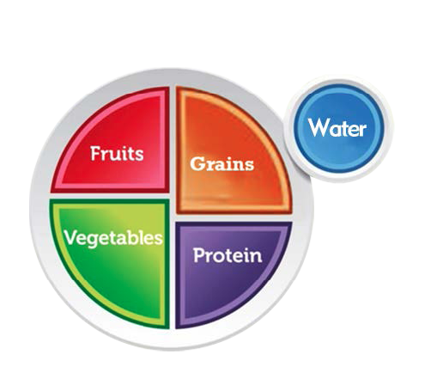
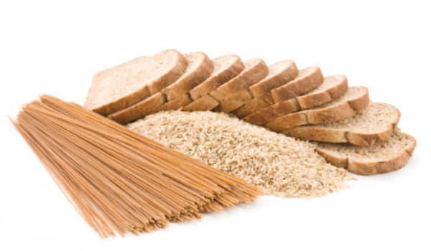
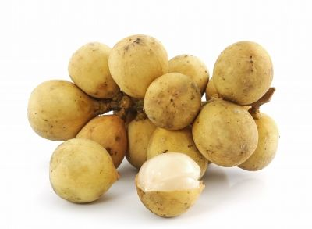
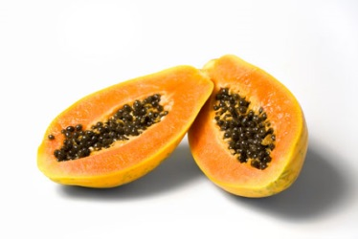
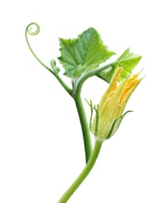
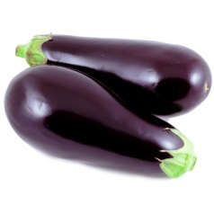
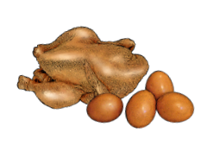
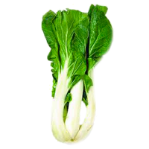
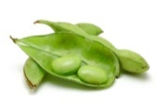
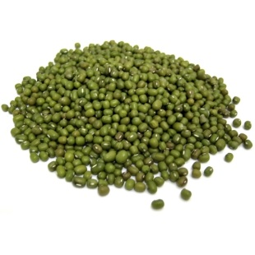
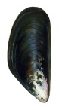
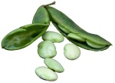
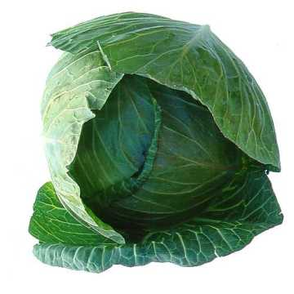
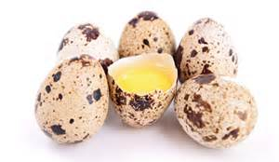
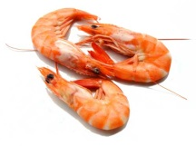
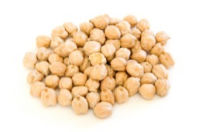
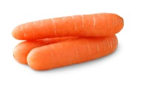
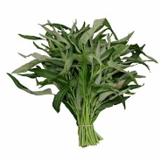
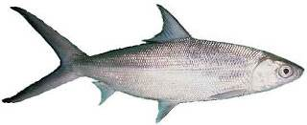
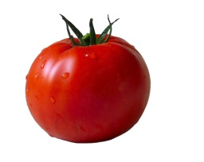
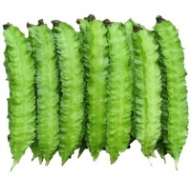

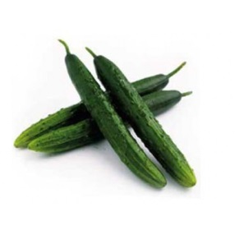
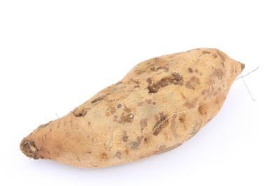
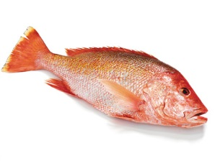
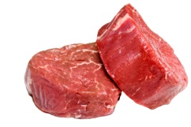
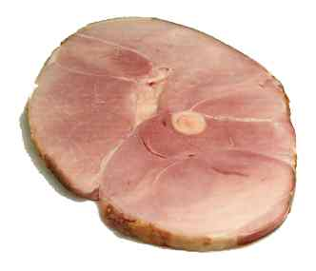
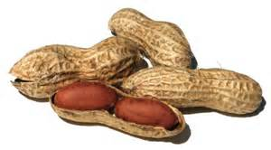
What does a diverse diet look like?

Slide 4
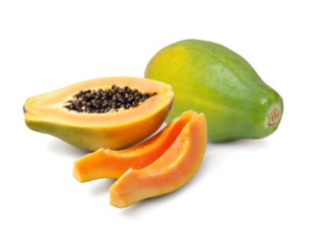
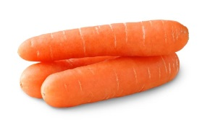


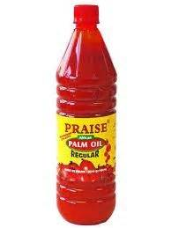
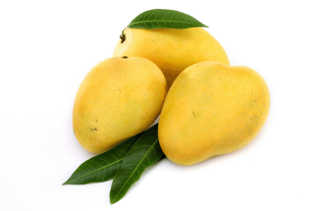
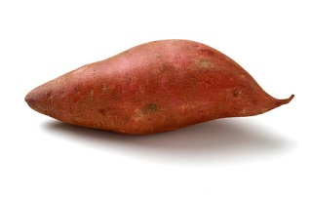
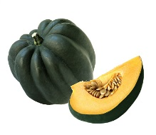
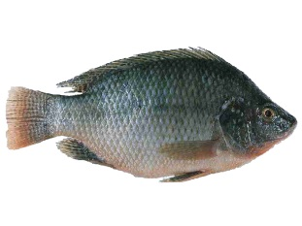
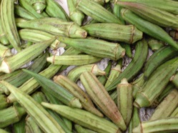
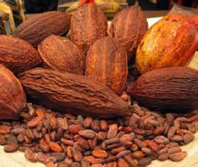

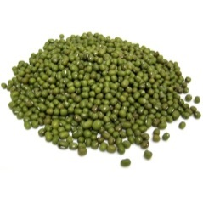

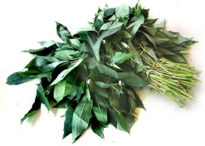



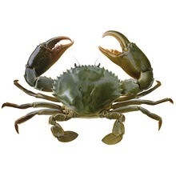




How do we get Ghanaians to eat a healthier diet?
Vitamin A
Increase vitamin A intake through consumption of crops with high carotene contents such as milks, liver, eggs, fish, butter, red palm oil, mangoes, papayas, carrots, pumpkins, yellow-orange sweet potatoes, and dark green leafy vegetables.
Vitamin A Deficiency
Zinc
Prevent Zinc-Deficiency through consumption of crops with high zinc contents such as groundnuts, okra, seafood, cocoa and chicken, sweet potatoes.
Zinc Deficiency
Iron
Iron- Deficiency Anemia
Prevent Iron-Deficiency Anemia through consumption of crops with high iron contents such as pumpkin, eggs, green, leafy vegetables, legumes such as groundnuts and peas and meat (including organ meat), fish, poultry, and eggs
Iodine
Prevent Iodine Deficiency through consumption of iodized salt and the consumption of seafood such as tilapia, clams, snails, mud crabs, prawns
Iodine Deficiency
Sources: Ghana DHS 2008, 2012 Ghana CFSVA

Slide 5


Introducing…
A Facebook social game to encourage healthy eating and lifestyle, but could potentially be multi-platform
Accessible by anyone with a Facebook account in Ghana, West Africa… and the world!

Slide 6
Product features
Personalized, dynamic avatar based on your lifestyle / diet
Tutorials on healthy eating, nutrition, diet tips
Food logger with open source food database (with Ghanaian staple foods like banku, fufu, etc.) that provides customized recommendations
Interaction and competition with Facebook friends and their ChopBuddies to be the “healthiest”
Photo auto-recognition functionality to allow food to be automatically tagged when users upload pictures of their meals to Facebook via Instagram
Healthy food market geo-locator to help users locate sellers of healthy foods
Commercialized food seller app for advertising their products and record/verify user purchases to earn treats
Earn or buy “Treatz” at the Treatz Store for your ChopBuddy
Incorporating exercise & fitness by partnering with wearable devices like FitBit to log exercise
Registry of dieticians located close to the user based on GPS with contact information
Core
Future
expansion

Slide 7
Product demo

Slide 8
Choose your ChopBuddy
Select a ChopBuddy based on your diet preference. Are you…
Vegetarian bunny?
Meat lover puppy?
On-a-diet bird?
Bulking up lion?
Athletic zebra?
Specialized avatars for children and older people
Include health conditions like diabetes, high blood pressure (low-sodium), heart disease (low-cholesterol), etc.

Slide 9
Game tutorial
Log your food and your ChopBuddy gets fed what you eat
Track your ChopBuddy’s energy level everyday
Get energy from logging your food
Get BONUS energy from eating healthy food
Race with your friends’ ChopBuddies every week to earn Treatz
Leaderboard to track race results and see what the winner ate
Treatz Store where users can buy Treatz or spend their Treat points from winning races

Slide 10

Healthy eating tutorial
What should you eat to have the happiest ChopBuddy?
Tutorial on a “balanced plate” and components of diet

Slide 11
ChopBuddy dashboard
You’ve eaten a lot of banku today so your ChopBuddy is tired. Why don’t you try some vegetables?
Breakfast
Lunch
Dinner
Log your food
See your friends
Visit Treatz Store

Slide 12

Log your food
For breakfast, you ate:
Waakye
Plantains
Red-red
Nutritional facts:
20g protein
50g fat
30g carbohydrates
10% Vitamin A
5% Iron
7% Zinc
Chale! Too much waakye makes me sleepy ooo…
Could you feed me some spinach? ☺

Slide 13
Food log analysis
+5
You can do better! Try eating more vegetables today like spinach, cabbage, or eggplant.
Want some ideas on what to cook?
Where can I find some healthy food?
How are my friends’ ChopBuddies doing?
Can I talk to a dietician to learn more?
Recipe ideas
Healthy food market
See your friends
Find a dietician

Slide 14






Treatz Store
Welcome to the Treatz Store! Use your Treatz points to make your ChopBuddy happy ☺
Designer Purse 60 pts
Jewelry 20 pts
Hat 20 pts
Sunglasses 50 pts
Buy Now
Tattoo 50 pts
Speed Sneakers 100 pts
Notes:
Tattoo, jewelry, hats, sneakers

Slide 15
Long term expansion plans
Longer term, we have an eye towards sustainability and commercialization of ChopBuddy. To do this, we need to build strategic partnerships with healthy food vendors, image recognition software vendors, wearable tech companies, and dieticians. We have the following expansion plans:
Connecting users with healthy food vendors in their neighborhood
Photo auto-recognition of food
Incorporating exercise & fitness trackers
Registry of dieticians for counseling

Slide 16
Helping you find healthy food vendors
We want to connect shops, restaurants and other
vendors of healthy food to ChopBuddy.
- Users of ChopBuddy will be able to find healthy food vendors nearby using geolocation tools.
- Vendors will earn more revenue from ChopBuddy customer referrals, and customers will be rewarded loyalty Treatz for shopping at associated vendors.
1
2

Slide 17

Helping you find healthy food vendors
The app will access the user’s GPS and determine which associated vendors are close to the user.
By going there to shop the user will be rewarded Treatz points.
Treatz can later be used in the in-game shop to purchase items to customise your ChopBuddy.
Additionally the Vendor might choose to provide the user with a loyality reward, i.e. giving every 10th item for free.

Slide 18

Healthy food vendor purchases

Slide 19


Photo auto-recognition of food
Instead of manually logging each food item you ate, what if you could take pictures of your meals and a photo auto-recognition service could automatically tag all your food items?
Your lunch plate had:
Lettuce
Tomato
Burger
Potatoes
Is this correct?
Connected cloud service automatically recognizes the food items on your plate!
Take a picture of your meal
Upload your picture onto Facebook via Instagram

Slide 20



Incorporating exercise & fitness logs
Being healthy is not just about nutrition, but also about exercise and staying physically active.
ChopBuddy wants you to log your exercise activities (running, football, basketball, etc.). If you have a or other fitness tracker wearable device, sync it with Chop- Buddy to get a holistic view of your health.

Slide 21

Registry of dieticians for counseling
There is the lack of proper nutritional education in school, and most Ghanaians do not know how to structure a proper diet for their health needs. This becomes especially important if one has health conditions with specific dietary requirements, such as diabetes, heart disease, or high blood pressure.
ChopBuddy wants to create a registry of local, trusted dieticians who are available for counseling, which users can access through the Facebook app. This is a referral channel for dieticians, and we can collect a fee on each successful referral.

